Slide 1
Accelerating Systems with Programmable Logic Components Lecture 13 Convolutional neural network
1DT109 ASPLOC
2022 VT1-VT2
Yuan Yao, yuan.yao@it.uu.se

Slide 2
Agenda
The gradient vanishing problem
Convolutional neural network
Local receptive field
Shared weights and biases
Pooling

Slide 3

Previously on Lecture 11-12
Corollary 1: $δ^{L}=∇_{a}C_{x}⊙σ^{′}\left(z^{L}\right)$
Corollary 2: $δ^{l}=\left({\left(w^{l+1}\right)}^{T}∙δ^{l+1}\right)⊙σ^{′}\left(z^{l}\right)$
Corollary 3: $\frac{∂C_{x}}{∂b_{j}^{l}}=δ_{j}^{l}$
Corollary 4: $\frac{∂C_{x}}{∂w_{jk}^{l}}={a_{k}^{l−1}δ}_{j}^{l}$

Slide 4
Previously on Lecture 11-12
Based on Corollary 1-4, we have built a neural network to do a pretty job recognizing images of handwritten digits.
We did this using networks in which adjacent network layers are fully connected to one another.
For each pixel in the input image, we encoded the pixel's intensity as the value for a corresponding neuron in the input layer.
For the 28×28-pixel images we’ve been using, this means our network has 784 (28×28=784) input neurons.
We then trained the network’s weights and biases so that the network’s output would correctly identify input images.

Slide 5



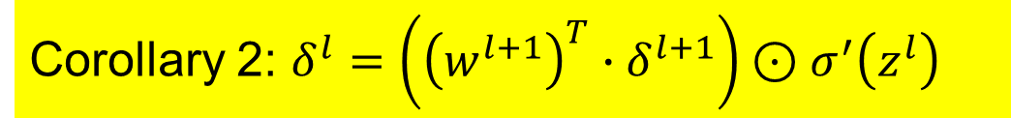
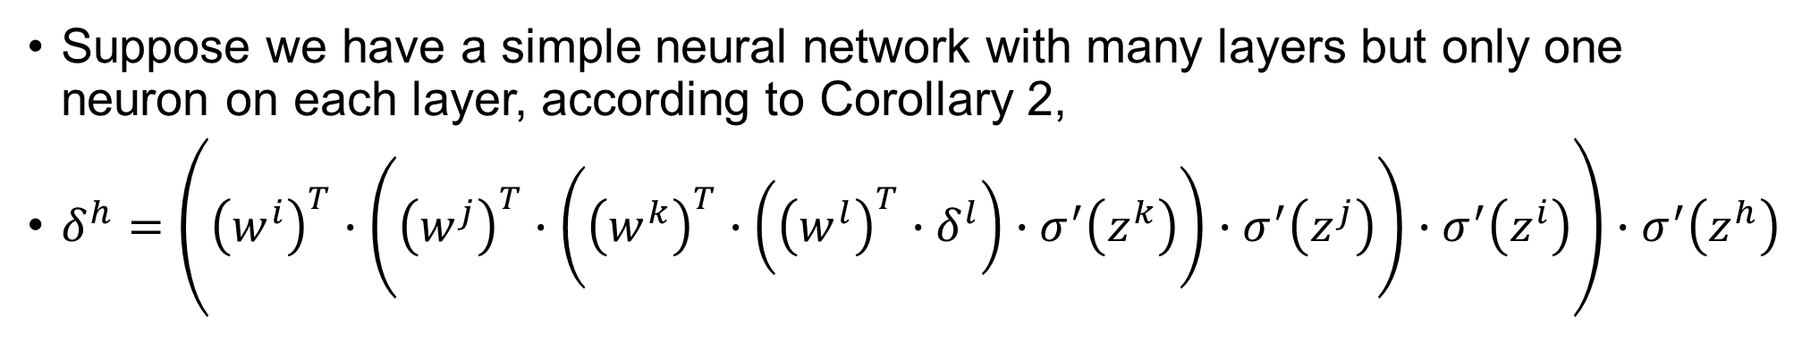





The gradient vanishing problem
Corollary 2: $δ^{l}=\left({\left(w^{l+1}\right)}^{T}∙δ^{l+1}\right)⊙σ^{′}\left(z^{l}\right)$
Suppose we have a simple neural network with many layers but only one neuron on each layer, according to Corollary 2,
$δ^{h}=\left({\left(w^{i}\right)}^{T}∙\left({\left(w^{j}\right)}^{T}∙\left({\left(w^{k}\right)}^{T}∙\left({\left(w^{l}\right)}^{T}∙δ^{l}\right)∙σ^{′}\left(z^{k}\right)\right)∙σ^{′}\left(z^{j}\right)\right)∙σ^{′}\left(z^{i}\right)\right)∙σ^{′}\left(z^{h}\right)$
$$δ^{k}$$
$$δ^{j}$$
$$δ^{i}$$
$$δ^{h}$$
$$δ^{i}$$
$$δ^{j}$$
$$δ^{k}$$
$$δ^{l}$$

Slide 6
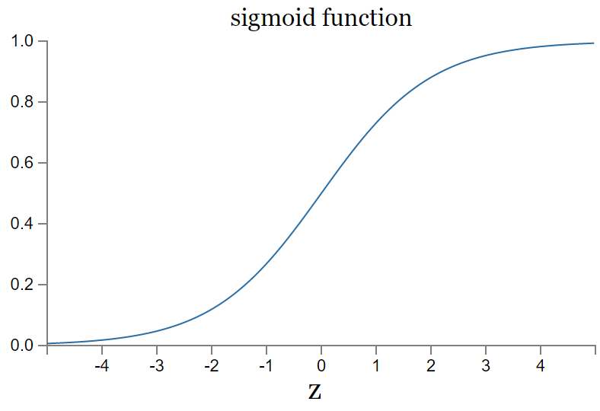


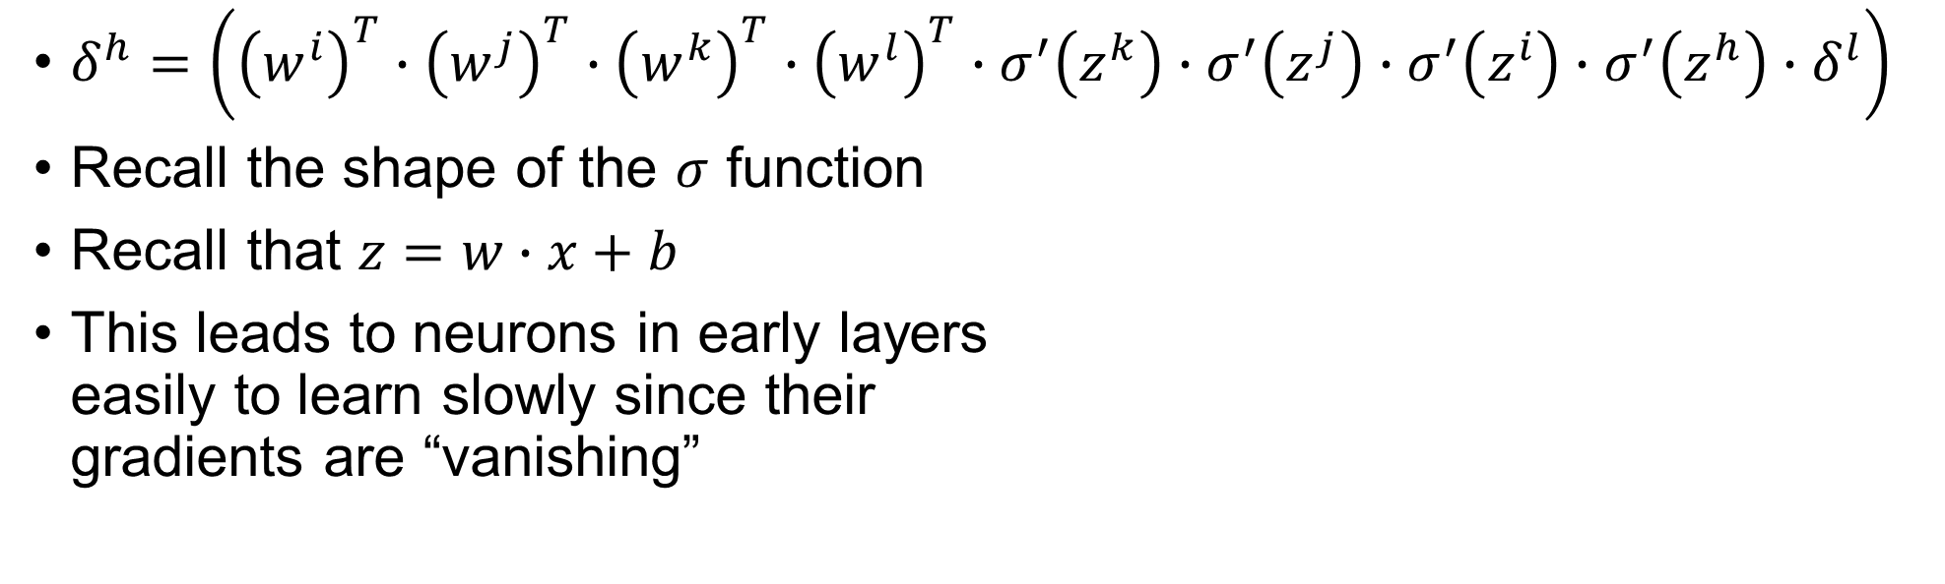






The gradient vanishing problem
$δ^{h}=\left({\left(w^{i}\right)}^{T}∙{\left(w^{j}\right)}^{T}∙{\left(w^{k}\right)}^{T}∙{\left(w^{l}\right)}^{T}∙σ^{′}\left(z^{k}\right)∙σ^{′}\left(z^{j}\right)∙σ^{′}\left(z^{i}\right)∙σ^{′}\left(z^{h}\right){∙δ}^{l}\right)$
Recall the shape of the $σ$ function
Recall that $z=w∙x+b$
This leads to neurons in early layers easily to learn slowly since their gradients are “vanishing”
Shallow networks will not help here since deeper networks more “powerful”
$$z^{x}$$
$$σ^{′}\left(z^{x}\right)≈0$$
$$σ^{′}\left(z^{x}\right)≈0$$
$$δ^{h}$$
$$δ^{i}$$
$$δ^{j}$$
$$δ^{k}$$
$$δ^{l}$$

Slide 7
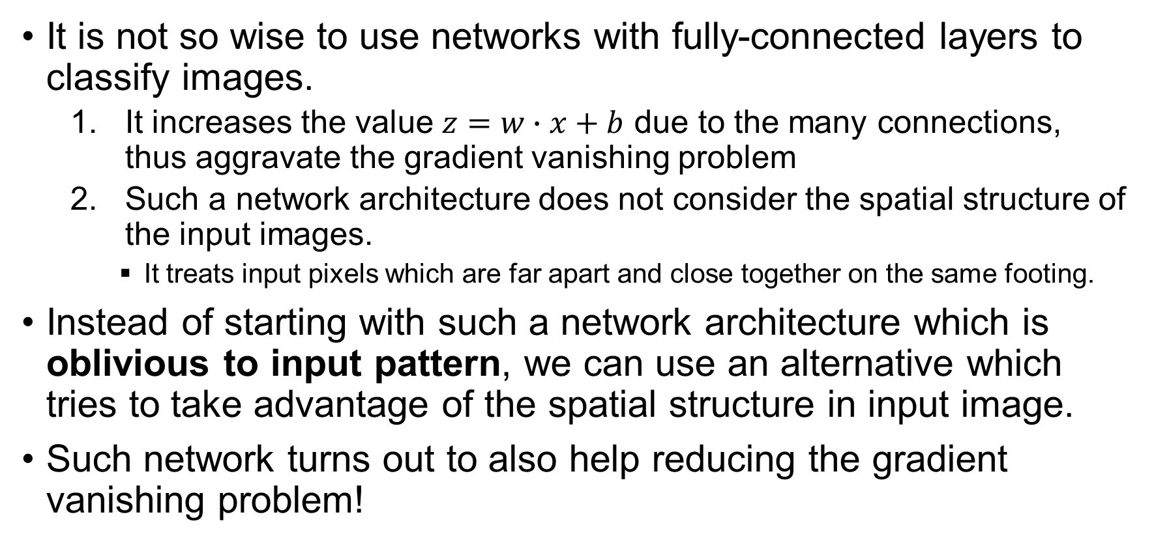
Convolutional neural network
It is not so wise to use networks with fully-connected layers to classify images.
It increases the value $z=w∙x+b$ due to the many connections, thus aggravate the gradient vanishing problem
Such a network architecture does not consider the spatial structure of the input images.
It treats input pixels which are far apart and close together on the same footing.
Instead of starting with such a network architecture which is oblivious to input pattern, we can use an alternative which tries to take advantage of the spatial structure in input image.
Such network turns out to also help reducing the gradient vanishing problem!
In this lecture we will introduce one of such networks, which is called Convolutional Neural Network (CNN)

Slide 8
Convolutional neural network
The origins of convolutional neural networks go back to the 1970s.
The popularity of modern convolutional neural network is triggered by the paper “Gradient-based learning applied to document recognition”, by Yann LeCun, Léon Bottou, Yoshua Bengio, and Patrick Haffner.
Interestingly, LeCun remarked his CNN as “convolution nets” since the “The biological neural inspiration in models like convolutional nets is very tenuous.”
But people still tend to call such networks neural networks nowadays.

Slide 9
Convolutional neural network
Convolutional neural networks use three basic ideas.
Local receptive field
Shared weights and biases
Pooling
We will look at each of these ideas.

Slide 10
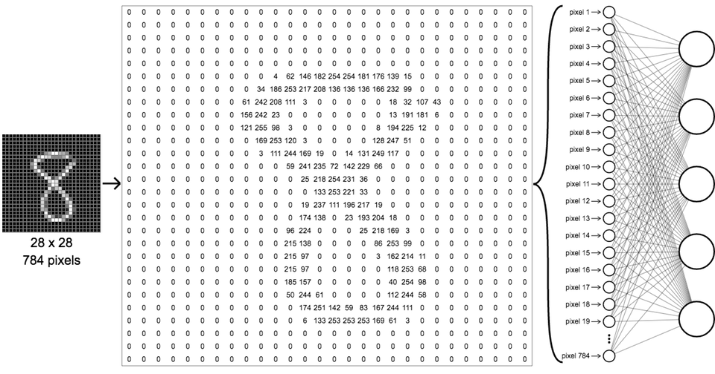





Local receptive field – motivation
First layer, the input layer
Second layer, the first hidden layer
A lot of pixels in the input has a strong local correlation.
$$z_{1}^{2}$$
Each neuron in the first hidden layer accepts 784 weights plus 1 bias, which will easily lead to gradient vanishing.
$$z_{2}^{2}$$
$$z_{3}^{2}$$
$$z_{4}^{2}$$
$$z_{j}^{2}$$

Slide 11
Local receptive field
In fully-connected network shown earlier, the inputs were depicted as a vector of pixels.
The whole pixel vector is input to each neuron in the first hidden layer.
In CNN, we won’t input the whole pixel vector to every hidden neuron in the first hidden layer.
Instead, we only make connections in small, localized regions of the input image, and feed it to one neuron in the first hidden layer.
Input image
All the input pixels are input to each neuron of the first hidden layer.
Only the marked pixels (5x5) will be input to one neuron in the first hidden layer.

Slide 12





Fully-connected net
$$z_{1}^{2}$$
784 weights
$$z_{2}^{2}$$
Input image
The whole pixel vector is input to each neuron in the first hidden layer.
First hidden layer
$$z_{3}^{2}$$
$$z_{4}^{2}$$
Different neurons have different set of its 784 weights.
$$z_{j}^{2}$$

Slide 13










Convolutional neural network
25 weights
$$z_{1}^{2}$$
25 weights
$$z_{1}^{2}$$
$$z_{2}^{2}$$
$$z_{2}^{2}$$
$$z_{3}^{2}$$
$$z_{3}^{2}$$
One window (called a receptive field) of the input pixels is input to one neuron in HL 1.
$$z_{4}^{2}$$
We then slide the local receptive field across the entire input image.
$$z_{4}^{2}$$
$$z_{j}^{2}$$
$$z_{j}^{2}$$

Slide 14


Convolutional neural network
576 neurons
$$z_{1}^{2}$$
81 neurons
$$z_{1}^{2}$$
25 weights
25 weights
$$z_{2}^{2}$$
$$z_{2}^{2}$$
$$z_{3}^{2}$$
$$z_{3}^{2}$$
If we slide 1 pixel each time to the right (a stride), there will be 576 (24×24) neurons in HL 1.
$$z_{4}^{2}$$
If we slide 3 pixel columns each time, there will be 81 (9×9) neurons in HL 1.
$$z_{4}^{2}$$
$$z_{576}^{2}$$
$$z_{81}^{2}$$

Slide 15





Local receptive field
A lot of pixels in the input has a strong local correlation.
$$z_{1}^{2}$$
25 weights
$$z_{2}^{2}$$
$$z_{3}^{2}$$
$$z_{4}^{2}$$
$$z_{j}^{2}$$

Slide 16
Local receptive field
A lot of pixels in the input has a strong local correlation.
$$z_{1}^{2}$$
25 weights
$$z_{2}^{2}$$
$$z_{3}^{2}$$
$$z_{4}^{2}$$
$$z_{j}^{2}$$

Slide 17
Local receptive field
A lot of pixels in the input has a strong local correlation.
$$z_{1}^{2}$$
25 weights
$$z_{2}^{2}$$
$$z_{3}^{2}$$
$$z_{4}^{2}$$
$$z_{j}^{2}$$

Slide 18
Local receptive field
A lot of pixels in the input has a strong local correlation.
$$z_{1}^{2}$$
25 weights
Each neuron in the first hidden layer accepts 25 weights plus a bias, which will help reducing gradient vanishing.
$$z_{2}^{2}$$
$$z_{3}^{2}$$
$$z_{4}^{2}$$
$$z_{j}^{2}$$

Slide 19
Shared weights and biases – motivation
Should we use the same or different weights/biases for each local receptive filed in the input image?
Observation 1: One set of 5×5 weights and bias is sensitive to one pattern in the input image.
1 set of weights + bias = 1 pattern
Observation 2: Shared weights and bias will significantly reduce the number of trainable parameters.
We can further reduce trainable parameters on top of local receptive field.

Slide 20

Recall from Lecture 02
Conv. Kernel
1
1
0
1
1
0
1
0
1
Conv
1
0
1
LRF 1
1
1
1
1
1
1
1x1+1x1+0x0+1x1+0x0+1x1+1x1+1x1+1x1 = 7
1
0
0
1
1
0
0
0
0
Conv
1
0
1
LRF 2
1
0
0
1
1
1
1x1+0x1+0x0+0x1+0x0+0x1+1x1+0x1+0x1 = 2

Slide 21
Shared weights and biases
In fully-connected network, each neuron in the first hidden layer has its own set of weights and biases.
However, in CNN, each hidden neuron has a shared bias and 5×5 weights connected to its local receptive field.
25 weights
784 weights
Input image
Different neurons have different set of its 784 weights.
Different neurons have the same shared set of its 25 weights.

Slide 22


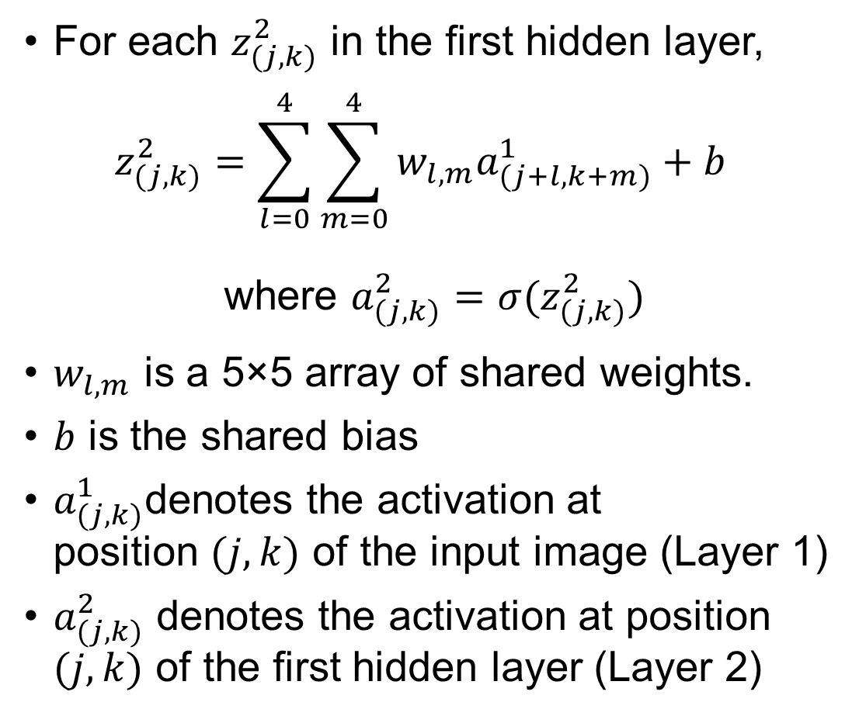



Shared weights and biases
For each $z_{(j,k)}^{2}$ in the first hidden layer, $z_{(j,k)}^{2}=\sum_{l=0}^{4}{\sum_{m=0}^{4}{w_{l,m}a_{(j+l,k+m)}^{1}}}+b$
where $a_{(j,k)}^{2}=σ(z_{(j,k)}^{2})$
$w_{l,m}$ is a 5×5 array of shared weights.
$b$ is the shared bias
$a_{(j,k)}^{1}$denotes the activation at position $(j,k)$ of the input image (Layer 1)
$a_{(j,k)}^{2}$ denotes the activation at position $(j,k)$ of the first hidden layer (Layer 2)
Different neurons have the same shared set of its 25 weights.
$${σ(z}_{(0,0)}^{2})$$
$${σ(z}_{(18,4)}^{2})$$
$${σ(z}_{(8,10)}^{2})$$
$${σ(z}_{(16,13)}^{2})$$
$${σ(z}_{(5,22)}^{2})$$

Slide 23
Shared weights and biases
We call the weights defining the feature map the shared weights.
we call the bias defining the feature map in this way the shared bias.
The shared weights and bias are often said to define a kernel or filter.
Via training, shared weights and biases enable all the neurons in the first hidden layer sensitive to the same localized feature in input images.
The step length with which we slide the convolution kernel is call a stride width.

Slide 24

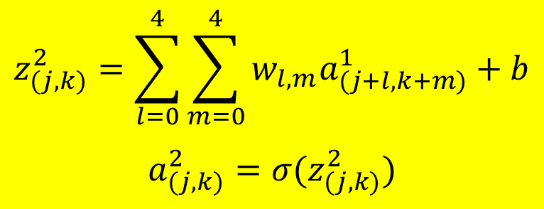
Shared weights and biases
We can organize $a_{(j,k)}^{2}$ as a two-dimensional “image”, too. If so, we call the first hidden layer as the first feature map layer.
28×28 input image
24×24 feature map
(the first hidden layer)
$$z_{(j,k)}^{2}=\sum_{l=0}^{4}{\sum_{m=0}^{4}{w_{l,m}a_{(j+l,k+m)}^{1}}}+b$$
$$a_{(j,k)}^{2}=σ(z_{(j,k)}^{2})$$

Slide 25
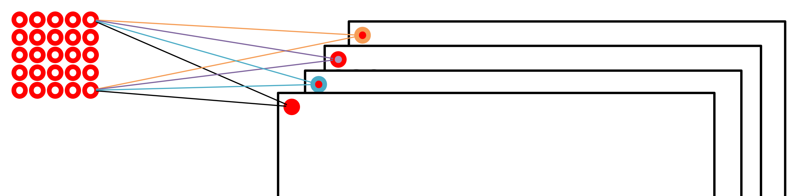
Feature map
To do image recognition we'll need more than one feature map. And so, a complete convolutional layer consists of several different feature maps.
In the example below there are 4 feature maps. Each feature map is defined by a unique set of 5×5 shared weights, and a single shared bias.
4 of 24×24 feature maps
(the first hidden layer)
Each color denotes a different set of convolution kernel.
28×28 input image

Slide 26
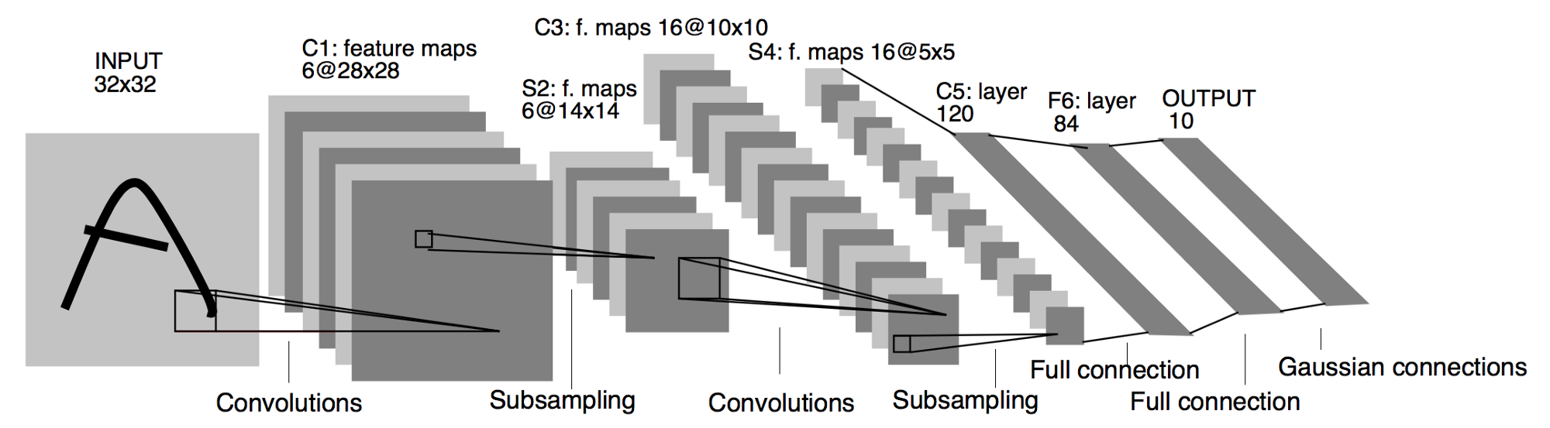
Feature map
In practice, convolutional networks may use more (and perhaps many more) feature maps.
One of the early convolutional networks, LeNet-5 by Yann LeCun, used 6 feature maps, each associated to a 5×5 local receptive field, to recognize MNIST digits.

Slide 27
Local receptive field + Shared weights and biases
A big advantage of local receptive field + sharing weights and biases is that they greatly reduce the number of parameters involved in a convolutional network.
Suppose we have a fully connected first layer with 30 neurons.
Each neuron will have 784 = 28×28 weights + 1 bias.
Totally 23,550 = (784+1)×30 trainable parameters.
30 neurons in the first hidden layer.
Suppose we have a local receptive field based first layer with 30 feature maps. Assume that stride length is 1.
Each neuron will have 25 = 5×5 shared weights + 1 shared bias.
Total 780 = (25+1)×30 parameters.
17,280 = 24x24x30 neurons in the first hidden layer
Trainable parameters: 23,550 → 780.
~30x reduction.
Neurons in the first HL: 30 → 24x24x30=17,280. ~576x increment.
Less training but more neurons!

Slide 28
Pooling layer – motivation
In addition to local receptive field and shared weights/biases, CNN also contains pooling layers.
Pooling layers are usually used immediately after convolutional layers to simplify the information in the output from the convolutional layer, such as the first hidden layer we have discussed.
A pooling layer takes each feature map output from the convolutional layer and prepares a condensed feature map.
One common procedure for pooling is known as max-pooling. In max-pooling, a pooling unit simply outputs the maximum activation in an input region.
Another way of pooling is called L2 pooling: we take the square root of the sum of the squares of the activations in the 2×2 region.

Slide 29
Pooling layer
For instance, each unit in the pooling layer may summarize a region of, e.g., 2×2 neurons in the previous layer.
Notice that since we have 24×24 neurons output from the convolutional layer, after pooling we have 12×12 neurons.
28×28 input image
24×24 feature map/convolution layer
(the 1st hidden layer)
12×12 pooling layer
(the 2nd hidden layer)
Find the max value among the 2×2 region.

Slide 30
Pooling layer
The convolutional layer usually involves more than a single feature map, so does the pooling layer
We apply max-pooling to each feature map separately.
We can view pooling as a way to compress (although in a loss way) the convolution layer.
4 of 24×24 convolution layer
(the 1st hidden layer)
28×28 input image
4 of 12×12 pooling layer
(the 2nd hidden layer)
Convolution
Max-pooling

Slide 31
Putting it all together
Fully connection output layer
28×28 input image
24×24 feature map
convolution layer
(the 1st hidden layer)
12×12 pooling layer
(the 2nd hidden layer)
Convolution
Max-pooling

Slide 32
Putting it all together
The network begins with 28×28 input neurons, which are used to encode the pixel intensities for the MNIST image.
This is then followed by a convolutional layer using 5×5 local receptive field and 3 convolution kernels. The result is a layer of 3×24×24 hidden feature neurons.
The next step is a max-pooling layer, applied to 2×2 regions, across each of the 3 feature maps. The result is a layer of 3×12×12 hidden feature neurons.
The final layer of connections in the network is a fully-connected layer. That is, this layer connects every neuron from the max-pooled layer to every one of the 10 output neurons.

Slide 33
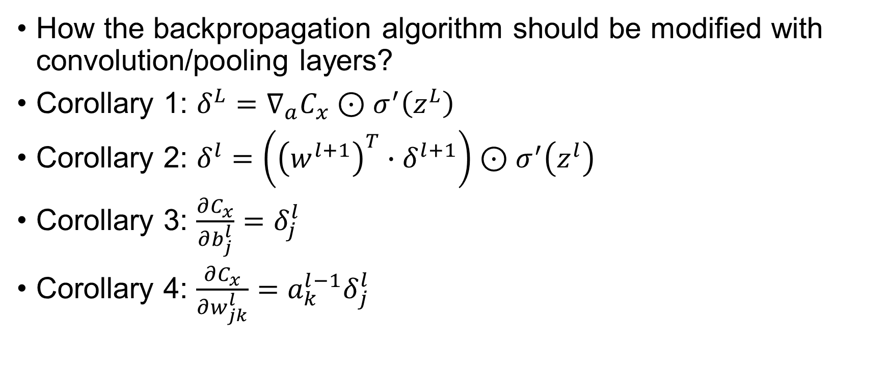
Discussion and exercise
How the backpropagation algorithm should be modified with convolution/pooling layers?
Corollary 1: $δ^{L}=∇_{a}C_{x}⊙σ^{′}\left(z^{L}\right)$
Corollary 2: $δ^{l}=\left({\left(w^{l+1}\right)}^{T}∙δ^{l+1}\right)⊙σ^{′}\left(z^{l}\right)$
Corollary 3: $\frac{∂C_{x}}{∂b_{j}^{l}}=δ_{j}^{l}$
Corollary 4: $\frac{∂C_{x}}{∂w_{jk}^{l}}={a_{k}^{l−1}δ}_{j}^{l}$
Let’s do an inspiration case together!

Slide 34
Good practice to reduce gradient vanishing
Using convolutional layers greatly reduces the number of parameters in those layers, making the learning problem much easier.
Using more powerful regularization techniques (notably dropout and convolutional layers) to reduce overfitting (will be covered in Riccardo’s lecture).
Using rectified linear units instead of sigmoid neurons, to speed up training (will be covered in Riccardo’s lecture).
Using GPUs and being willing to train for a long period of time.

Slide 35
Good practice to train CNN (Riccardo’s lecture)
Making use of sufficiently large data sets (to help avoid overfitting)
Using the right cost function (to avoid a learning slowdown);
Using good weight initializations (also to avoid a learning slowdown, due to neuron saturation)
Algorithmically expanding the training data.

Slide 36
Recent progress in image recognition
In 1998, the year MNIST was introduced, it took weeks to train a state-of-the-art workstation to achieve accuracies substantially worse than those we can achieve using a GPU and less than an hour of training.
Now, CNN can reach (relatively) high recognition accuray of the ImageNet images.
The 2011 ImageNet data that they used included 16 million full color images, in 20 thousand categories.
The images were crawled from the open net, and classified by workers from Amazon's Mechanical Turk service.

Slide 37
LRMD net and AlexNet
The 2012 LRMD paper.
Obtained a respectable 15.8% accuracy for correctly classifying ImageNet images from previous best of 9.3%.
AlexNet
The work of LRMD was followed by a 2012 paper of Krizhevsky, Sutskever and Hinton, who named their CNN as AlexNet.
AlexNet is trained using the ImageNet Large-Scale Visual Recognition Challenge (ILSVRC) image subset (winner of ILSVRC 2012).
The ILSVRC-2012 training set contained about 1.2 million ImageNet images, drawn from 1,000 categories. The validation and test sets contained 50,000 and 150,000 images, respectively, drawn from the same 1,000 categories.

Slide 38
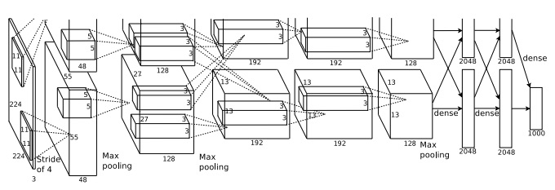
2014 ILSVRC competition – AlexNet
AlexNet achieved an accuracy of 84.7% in ILSVRC categorization accuracy (top-5), vastly better than the next-best contest entry, which achieved an accuracy of 73.8% percent.
63.3% exact recognization accuracy.
AlexNet has inspired much subsequent work.
Trained using two NVIDIA GeForce GTX 580 GPUs.
Observe the AlexNet architecture. Can you identify where the cross-GPU communication happens?

Slide 39
2014 ILSVRC competition – GoogLeNet
The winning team, based primarily at Google, used a deep convolutional network with 2222 layers of neurons.
They called their network GoogLeNet, as a homage to LeNet-5.
GoogLeNet achieved a top-5 accuracy of 93.3%, a giant improvement over the 2013 winner (Clarifai, with 88.3%), and the 2012 winner (AlexNet, with 84.7%).
How good GoogLeNet is?
An interesting blog showing that human can beat GoogLeNet by 1.7% better accuracy only through painstakingly training themselves …
… if not making the accuracy worse!

Slide 40
Multi-digit Number Recognition from Street View Imagery
In 2014, A team at Google applied deep convolutional networks to the problem of recognizing street numbers in Google's Street View imagery.
Detecting and automatically transcribing numbers at an accuracy similar to that of a human operator.
Transcribed all of Street View's images of street numbers in France in less than an hour!

Slide 41
Mastering the game of Go with deep neural networks and tree search
In 2016, AlphaGo (from DeepMind, acquired by Google in 2014 and became a wholly-owned subsidiary of Alphabet in 2015).
In October 2015, a computer Go program called AlphaGo, developed by DeepMind, beat the European Go champion Fan Hui (2nd dan) 5–0.
In March 2016 it beat Lee Sedol—a 9th dan Go player and one of the highest ranked players in the world—with a score of 4–1 in a five-game match.
In 2017, AlphaGo won a 3 — 0 game with Ke Jie, who at the time continuously held the world No. 1 ranking for two years.
AlphaGo used a supervised learning protocol, studying large numbers of games played by humans against each other.
Let it Go.

Slide 42
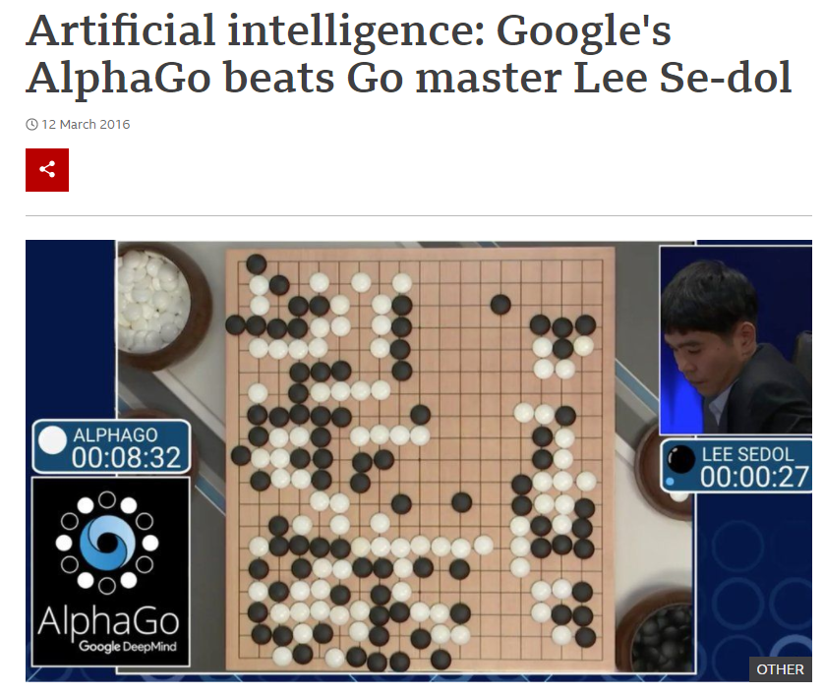
AI milestone: Machine beats Human champion at Go
Mar 12, 2016
AlphaGo has won 4:1 against the 18-time world Go champion Lee Sedol
Much better than the score of Deep Blue
More read: https://www.bbc.com/news/technology-35785875

Slide 43
Graph placement methodology for fast chip design
In 2021, a team in Google announced a fast way to do chip floorplanning for accelerators using deep learning.
Save thousands of hours of human effort.
Mirhoseini et al, “A graph placement methodology for fast chip design”, Nature, Vol 594, 10 June 2021.
You can find all the papers for these works (and many more) as seminar topic papers.

Slide 44
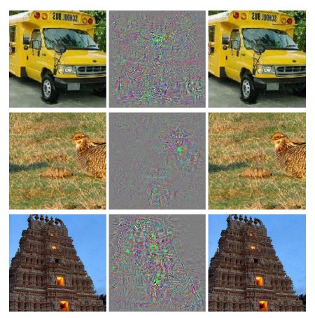
Is deep learning/CNN the best way to recognize images?
A 2013 paper showed that deep networks may suffer from what are effectively blind spots.
On the left is an ImageNet image classified correctly by their network.
On the right is a slightly perturbed image (the perturbation is in the middle) which is classified incorrectly by the network.
The noise is shown in the middle.
Are CNNs discontinuous if not broken?
It's not yet well understood what's causing the discontinuity.

Slide 45
A final remark
We have achieved high fidelity in the way deep learning networks improves
They can recognize handwritten digits
They can catogorize complex images in ImageNet
They can recognize street numbers in real applications
They can play Go, design chip, drive cars, etc.
But we still miss a fundemantal understanding of why deep learning works.

Slide 46

Questions?

